Slide 1
Basic Functions
Part 1

Slide 2
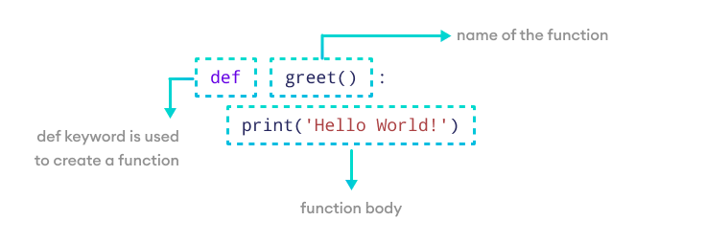
What is a Function?
Functions in Python are a fundamental concept that allow you to encapsulate code for reuse and organization.
A function is defined using the def keyword, followed by the function name and parentheses. The code block within the function is indented.

Slide 3
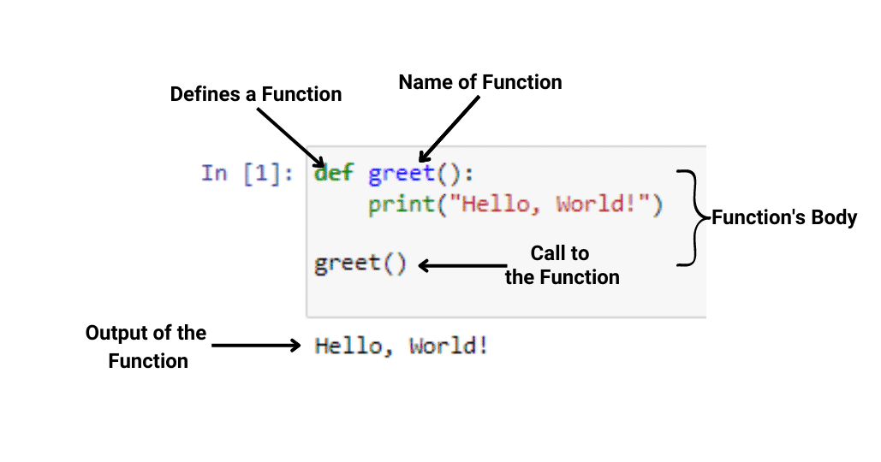
Calling a Function
To execute the function, you call it by its name followed by parentheses.

Slide 4
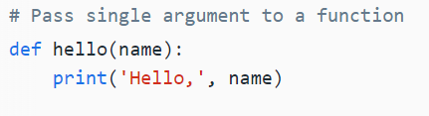
Arguments and Parameters
Functions can take arguments, which are specified in the parentheses during function definition. These arguments are accessible within the function as variables.
When you call a function with arguments, the values of those arguments are copied to their corresponding parameters inside the function.

Slide 5
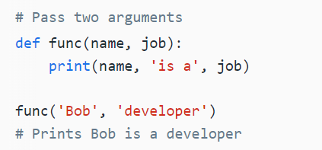
Multiple Arguments
You can send as many arguments as you like, separated by commas ,.

Slide 6
Types of Arguments
Python handles function arguments in a very flexible manner, compared to other languages. It supports multiple types of arguments in the function definition. Here’s the list:
Positional Arguments
Keyword Arguments
Default Arguments
Variable Length Positional Arguments (*args)
Variable Length Keyword Arguments (**kwargs)

Slide 7
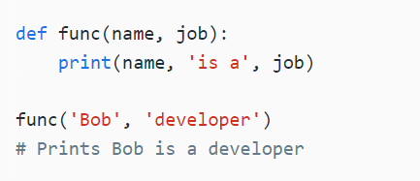
Positional Arguments
The most common are positional arguments, whose values are copied to their corresponding parameters in order.
The only downside of positional arguments is that you need to pass arguments in the order in which they are defined.

Slide 8
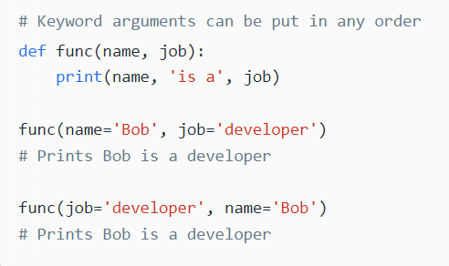
Keyword Arguments
To avoid positional argument confusion, you can pass arguments using the names of their corresponding parameters.
In this case, the order of the arguments no longer matters because arguments are matched by name, not by position.

Slide 9
Default Arguments
You can specify default values for arguments when defining a function. The default value is used if the function is called without a corresponding argument.
In short, defaults allow you to make selected arguments optional.

Slide 10
Variable Length Arguments (*args and **kwargs)
Variable length arguments are useful when you want to create functions that take unlimited number of arguments. Unlimited in the sense that you do not know beforehand how many arguments can be passed to your function by the user.

Slide 11
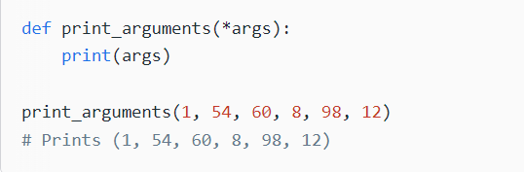
*args
When you prefix a parameter with an asterisk * , it collects all the unmatched positional arguments into a tuple. Because it is a normal tuple object, you can perform any operation that a tuple supports, like indexing, iteration etc.

Slide 12
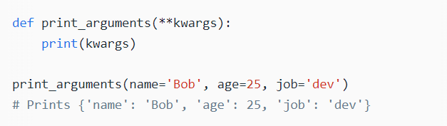
**kwargs
The ** syntax is similar, but it only works for keyword arguments. It collects them into a new dictionary, where the argument names are the keys, and their values are the corresponding dictionary values.

Slide 13
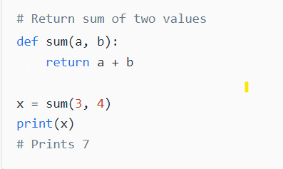
Return Value
To return a value from a function, simply use a return statement. Once a return statement is executed, nothing else in the function body is executed.

Slide 14
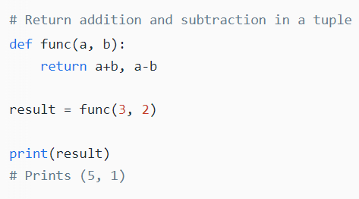
Return Multiple Values
Python has the ability to return multiple values, something missing from many other languages. You can do this by separating return values with a comma.

Slide 15
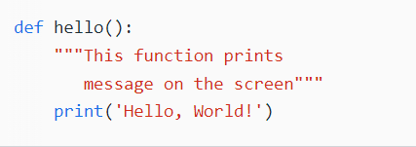
Docstring
You can attach documentation to a function definition by including a string literal just after the function header. Docstrings are usually triple quoted to allow for multi-line descriptions.

Slide 16
Questions
1. Write a Python function to find the maximum of three numbers.

Slide 17
Questions
2. Write a Python function to sum all the numbers in a list. Sample List : (8, 2, 3, 0, 7) Expected Output : 20

Slide 18
Questions
3. Write a Python function to multiply all the numbers in a list. Sample List : (8, 2, 3, -1, 7) Expected Output : -336

Slide 19
Questions
4. Write a Python program to reverse a string. Sample String : "1234abcd" Expected Output : "dcba4321"

Slide 20
Questions
5. Write a Python function to calculate the factorial of a number (a non-negative integer). The function accepts the number as an argument.

Slide 21
Questions
6. Write a Python function to check whether a number falls within a given range.

Slide 22
Questions
7. Write a Python function that accepts a string and counts the number of upper and lower case letters. Sample String : 'The quick Brow Fox' Expected Output : No. of Upper case characters : 3 No. of Lower case Characters : 12

Slide 23
Questions
8. Write a Python function that takes a list and returns a new list with distinct elements from the first list. Sample List : [1,2,3,3,3,3,4,5] Unique List : [1, 2, 3, 4, 5]

Slide 24

Thank you
More on functions in next class

